Slide 1

IdleCampus
A platform for connecting colleges with students

Slide 2
OUR MISSION AND VISION.
MISSION: To make sure all the needed and latest information is always available to the student anytime and anywhere.
VISION: To enable easy communication among colleges and students of not only the same but also different branches.

Slide 3

Why idleCampus?
Do you still get your class timetable as an email on your smartphones?
Is all your data like class schedules, group alerts, notifications for internships and placements getting lost in sms and whatsapp inbox?

Slide 5
Ummm….
THINK ABOUT IT…
Wouldn't it be nice if the timetable was sent to your mobile whenever there was a new one available like for a new semester.
Or getting notified when the timetable is changed anytime while the semester is going on?

Slide 6
LET US UNDERSTAND THE CONCEPT OF IDLECAMPUS
You can start connecting with your students and teachers directly by using IdleCampus.. Now you can just create an account for your college or university on http://idlecampus.com and start connecting with your students without having to depend on Blackboard or moodle.

Slide 7
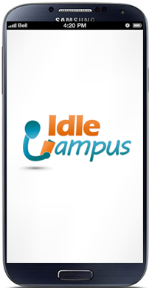
LET US SEE HOW TO ACCESS TO IDLECAMPUS!!!

Slide 8
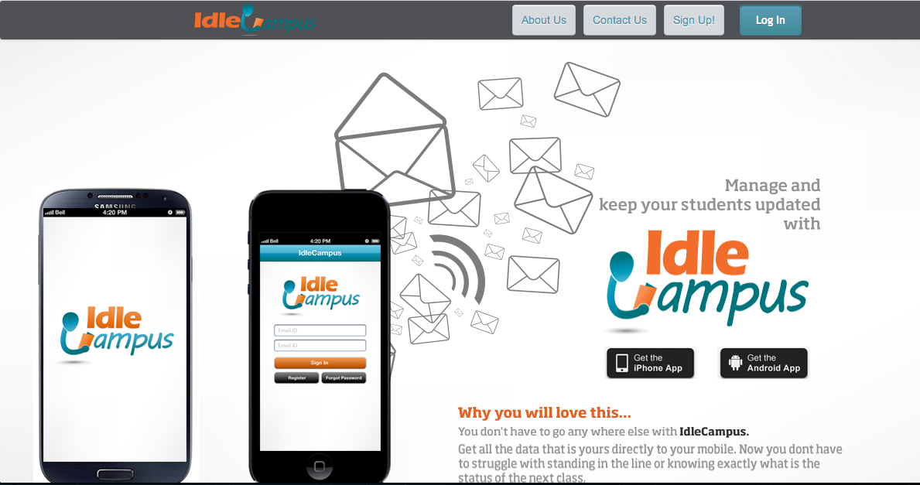
Click to create an account.
Click to login.
One click to get the iPhone app!!
One click to get the Android app

Slide 9

ADVANTAGES OF IDLECAMPUS
IDLECAMPUS provides each student an uniqiue id which helps in simple management. It can act as one of the best communication link between students of not only the ssame college but also the different colleges…

Slide 10
IDLECAMPUS WITHOUT SHARING YOUR MOBILE NUMBER…
You can even create numerous groups in Idle Campus. It can remind you or make you aware of your cultural festivals, management workshops etc.
AND THE BEST IS THAT YOU NEVER HAVE TO SHARE YOUR MOBILE NUMBER FOR THIS!!!

Slide 11
START USING!!!
Can be used right way on http://idlecampus.com for creating timetable for each group.
Website has links to IdleCampus apps for Android and iOS.

Slide 12
Thank You
Ankur Kothari

